Slide 1

Call Center Project Proposal
Here is where your presentation begins

Slide 2
Contents of this template
You can delete this slide when you’re done editing the presentation
Fonts | To view this template correctly in PowerPoint, download and install the fonts we used
Used and alternative resources | An assortment of graphic resources that are suitable for use in this presentation
Thanks slide | You must keep it so that proper credits for our design are given
Colors | All the colors used in this presentation
Icons and infographic resources | These can be used in the template, and their size and color can be edited
Editable presentation theme | You can edit the master slides easily. For more info, click here
For more info:
Slidesgo | Blog | Faqs
You can visit our sister projects:
Freepik | Flaticon | Storyset | Wepik | Videvo

Slide 3
Table of contents
01
02
03
04
05
06
Objectives
Resources
Budget
Solutions
Communication plan
Conclusion

Slide 4

How to create a project proposal
Creating a project proposal can be done in five steps:
Define the project objectives and timeline
Identify resources needed to complete the project
Develop a budget for the project and estimate any potential risks associated with it
Write down your proposed solution and provide supporting documents or evidence that prove its feasibility if necessary
Develop a communication plan to ensure key stakeholders are kept informed of progress throughout the entire process

Slide 5

01
Objectives
of the project

Slide 6
Objectives
Our aim
The goal
An aim in a corporate context is a goal or desired result that the organization seeks to achieve. The aim should be clear and achievable, and often serves as the basis for further planning actions inside the organization
Goals inside a company are usually specific and measurable, with clearly defined deadlines and outcomes. The company’s goals help focus the actions of the organization and ensure resources are used effectively

Slide 7
Resources
Human resources
Financial resources
Physical resources
The project team is responsible for the successful execution of the project. Our team is composed of experienced professionals with the necessary skills and expertise to complete the project on time and budget
Our project budget is $100,000 and it includes all expenses associated with the project, including salaries and equipment. We have allocated these resources to ensure that we are able to complete the project within budget
Our project requires a number of specialized pieces of equipment. We will be using [insert equipment and their functions]. All equipment is in good working condition and has been tested and calibrated prior to use

Slide 8
Budget
Sources of funding
Personnel costs
Funding for a company can come from personal savings or investments, bank loans and other loan options, venture capital and angel investors, grants, competitions or programs, crowdfunding…
Personnel costs refer to the expenses incurred in hiring, training and retaining staff for a company. This can include salaries, bonuses, benefits and other payroll-related costs for our company
Equipment and materials
Travel and miscellaneous
Equipment and materials costs refer to all the expenses related to the purchasing, maintenance and upkeep of any physical items used in production or other business processes inside the company
Travel and miscellaneous costs refer to expenses related to any travel-related activities. It may also include office supplies, communications services, licenses and other miscellaneous expenses

Slide 9
Solutions
Solution 1
Solution 2
Solution 3
Implementing a new CRM (Customer Relationship Management) system to improve data management
Outsourcing specific business functions to a third-party provider to reduce costs
Launching an e-commerce platform to expand the reach of the business and increase online sales
Solution 4
Solution 5
Solution 6
Developing a new product or service to diversify the business and increase revenue streams
Implementing a cost-saving initiative, such as energy-efficient practices, to reduce expenses
Establishing strategic partnerships with other businesses to gain access to new markets

Slide 10
$500,000
200 units
25%
Net profit of the project
Break-even point
Market share in the industry

Slide 11

10 million
First-year revenue of the project

Slide 12
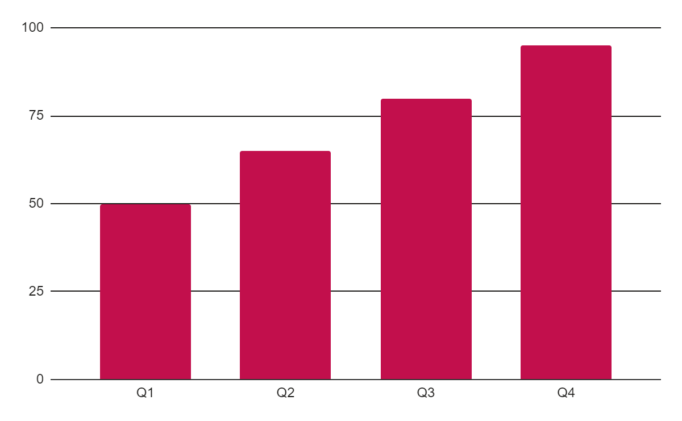
Project data
Benefits of using tables
Tables in project proposals offer visual organization, enabling clear presentation of information in a structured format. They enhance the visual appeal, facilitate data comparison and improve overall clarity and professionalism of your project proposal
Follow the link in the graph to modify its data and then paste the new one here. For more info, click here

Slide 13
Project activities
Activity | Start date | End date | Resource | Cost | Revenue
Market research | 1/1/20XX | 1/15/20XX | Market research firm | $20,000 | $1,500
Product development | 1/16/20XX | 6/30/20XX | R&D team | $200,000 | $15,000
Beta testing | 7/1/20XX | 8/15/20XX | Beta testers | $10,000 | $500
Marketing campaign | 1/1/20XX | 1/15/20XX | Advertising agency | $100,000 | $60,500
Product launch | 1/16/20XX | 6/30/20XX | Sales team | $50,000 | $500,000
Post-launch support | 7/1/20XX | 8/15/20XX | Support team | $50,000 | $800,000

Slide 14
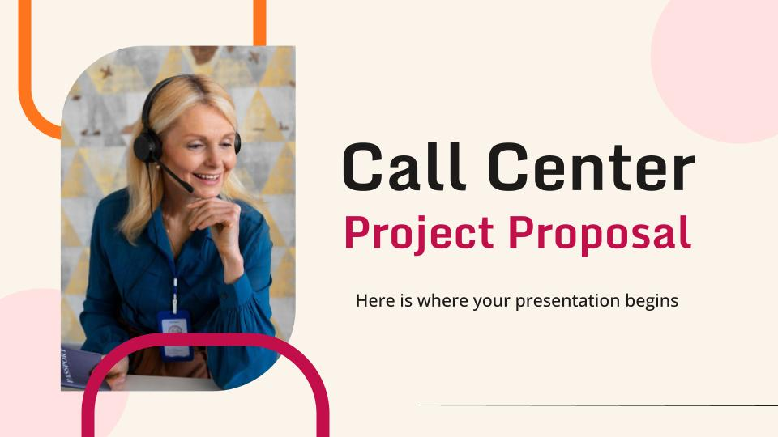
What to show in a mockup
Product/website description: A brief overview of the product/website, including its key features, dimensions, and materials used
Features and benefits: A detailed explanation of the product's/website's features and how they will benefit the user
Technical specifications: A list of the product's/website's technical specifications, such as dimensions, weight, power requirements, connectivity options and hosting platform

Slide 15
Project timeline
Conduct market research and analyze the target audience to identify opportunities
Create the product or service by defining features, design, and functionality
Test the product with a group of users to receive feedback and improve the product
Execute a marketing campaign to promote the product to the target audience
Release the product or service to the market with a comprehensive launch plan
Provide customer support to ensure customer satisfaction
Explore opportunities for growth and expansion of the product or service
Continuously improve the product based on customer feedback and market trends

Slide 16
Project roadmap
Initiative | Objective | Jan | Feb | Mar | Apr | May | Jun | Jul | Aug | Sep | Oct | Nov | Dec
Market research | Increase brand awareness by 30% within the first year
Product development | Achieve a customer satisfaction rate of 90%
Marketing campaign | Increase revenue by 20% within the first year
Product launch | Achieve a customer satisfaction rate of 90% within the first year
Expansion | Reduce costs by 15% within the first year by expanding the product
Partnership | Reach profitability within 18 months of launch

Slide 17


Photo showcase
A photo showcase can be a useful addition to a business project proposal as it can help to visually communicate the concept or idea being proposed

Slide 18
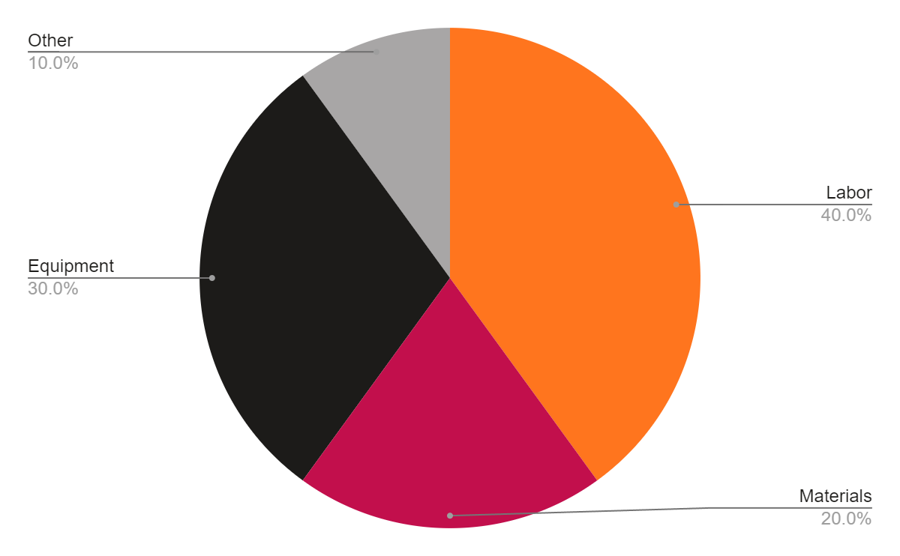
Project expenses
Labor
Materials
Equipment
Other
Follow the link in the graph to modify its data and then paste the new one here. For more info, click here

Slide 19
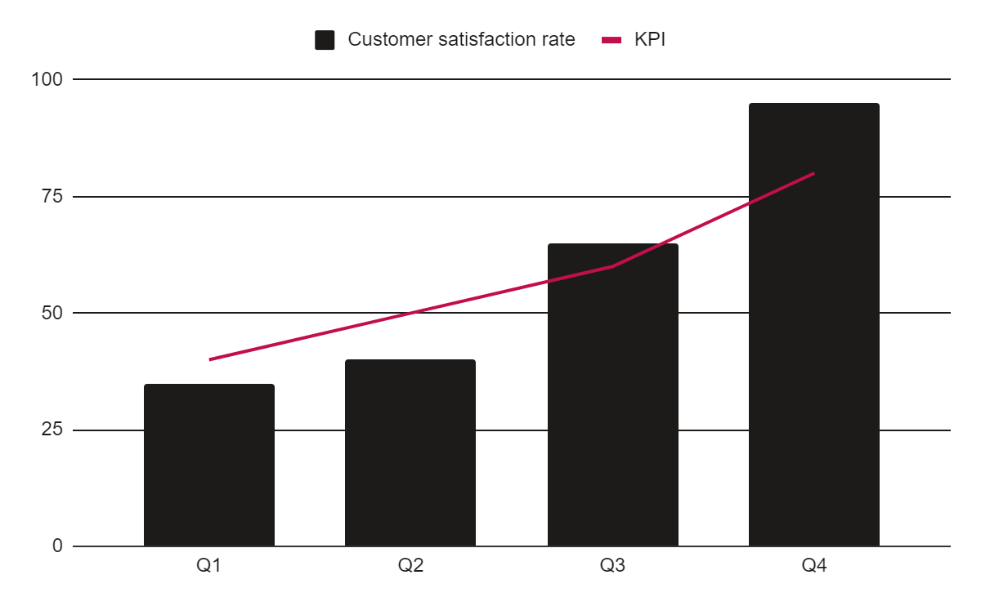
KPI dashboard
Resource | Utilization rate | Cost per unit
Labor | 85% | $50
Equipment | 70% | $100
Materials | 95% | $20
Rent | 90% | $1,000
Energy | 80% | $80
Software licenses | 80% | $200
120 u/day
2h
Output per worker
Time to complete a task
Follow the link in the graph to modify its data and then paste the new one here. For more info, click here

Slide 20

Thanks!
Do you have any questions?
youremail@freepik.com
+34 654 321 432
yourwebsite.com
Please keep this slide for attribution

Slide 21
Alternative resources
Here’s an assortment of alternative resources whose style fits the one of this template:
Photos:
Close up on person working in call center
Office worker using finance graphs
Colleagues working together in a call center office
Colleagues working together in a call center with headphones
Close up on person working in call center
People working in call center
Medium shot woman working on laptop
Smiley woman working in a call center office
Close up smiley women working

Slide 22
Resources
Did you like the resources on this template? Get them for free at our other websites:
Photos:
Medium shot woman working in the office of a travel agency
Office workers using finance graphs
Medium shot female economist working in office
Interior designer working out of the office
Medium shot female economist working on laptop
People working in call center
Colleagues working together in a call center office
Background:
Flat design lifestyle template

Slide 23
Instructions for use
If you have a free account, in order to use this template, you must credit Slidesgo by keeping the Thanks slide. Please refer to the next slide to read the instructions for premium users.
As a Free user, you are allowed to:
Modify this template.
Use it for both personal and commercial projects.
You are not allowed to:
Sublicense, sell or rent any of Slidesgo Content (or a modified version of Slidesgo Content).
Distribute Slidesgo Content unless it has been expressly authorized by Slidesgo.
Include Slidesgo Content in an online or offline database or file.
Offer Slidesgo templates (or modified versions of Slidesgo templates) for download.
Acquire the copyright of Slidesgo Content.
For more information about editing slides, please read our FAQs or visit our blog:
https://slidesgo.com/faqs and https://slidesgo.com/slidesgo-school

Slide 24
Instructions for use (premium users)
As a Premium user, you can use this template without attributing Slidesgo or keeping the "Thanks" slide.
You are allowed to:
Modify this template.
Use it for both personal and commercial purposes.
Hide or delete the “Thanks” slide and the mention to Slidesgo in the credits.
Share this template in an editable format with people who are not part of your team.
You are not allowed to:
Sublicense, sell or rent this Slidesgo Template (or a modified version of this Slidesgo Template).
Distribute this Slidesgo Template (or a modified version of this Slidesgo Template) or include it in a database or in any other product or service that offers downloadable images, icons or presentations that may be subject to distribution or resale.
Use any of the elements that are part of this Slidesgo Template in an isolated and separated way from this Template.
Register any of the elements that are part of this template as a trademark or logo, or register it as a work in an intellectual property registry or similar.
For more information about editing slides, please read our FAQs or visit our blog:
https://slidesgo.com/faqs and https://slidesgo.com/slidesgo-school

Slide 25
Fonts & colors used
This presentation has been made using the following fonts:
Monda
(https://fonts.google.com/specimen/Monda)
Open Sans
(https://fonts.google.com/specimen/Open+Sans)
#1c1b19
#fbf4ea
#c20f4c
##ffe1e1
#ff751e
#ffffff
#a8a6a6

Slide 26





Storyset
Create your Story with our illustrated concepts. Choose the style you like the most, edit its colors, pick the background and layers you want to show and bring them to life with the animator panel! It will boost your presentation. Check out how it works.
Pana
Amico
Bro
Rafiki
Cuate

Slide 27
Use our editable graphic resources...
You can easily resize these resources without losing quality. To change the color, just ungroup the resource and click on the object you want to change. Then, click on the paint bucket and select the color you want. Group the resource again when you’re done. You can also look for more infographics on Slidesgo.

Slide 30
JANUARY
FEBRUARY
MARCH
APRIL
MAY
JUNE
PHASE 1
Task 1
Task 2
PHASE 2
Task 1
Task 2
JANUARY
FEBRUARY
MARCH
APRIL
PHASE 1
Task 1
Task 2

Slide 33
...and our sets of editable icons
You can resize these icons without losing quality.
You can change the stroke and fill color; just select the icon and click on the paint bucket/pen.
In Google Slides, you can also use Flaticon’s extension, allowing you to customize and add even more icons.

Slide 34
Educational Icons
Medical Icons

Slide 35
Business Icons
Teamwork Icons

Slide 36
Help & Support Icons
Avatar Icons

Slide 37
Creative Process Icons
Performing Arts Icons

Slide 38
Nature Icons

Slide 39
SEO & Marketing Icons

Slide 40


